Slide 1
Lezione 4 Introduction to FPGAs and Xilinx devices
Stefan Cristi Zugravel 20/01/2026

Slide 2
Early times of digital electronics

Slide 3
Why programmable ICs?
Producing a Chip costs much more than producing a PCB
Using one Chip on many PCBs increases Number of Chips and reduces Costs per Chip
If a Chip is programmable, it can be used on many PCBs in different situations
Producing one wafer costs ~ 10k€
Not included manpower to design wafer & packaging
Saving space on a PCB

Slide 4
History of Programmable Logic Devices
● 1960th
– Fuse Configurable Diode Matrix
● 1971
– Programmable ROM
● 1978
– Programmable Array Logic PAL
– Gate Array Logic GAL (reprogrammable)
– Complex Programmable Logic Device CPLD (In circuit programmable)
Configured during programming → keep configuration
● 1989
– Field Programmable Gate Array FPGA
PLA Programmable Logic Array every boolean operation fixed logic gates and programmable interconnections (matrix) OTP (one time programmable)
Development process CLPD & FPGA is almost the same

Slide 6
What are FPGAs?
Field Programmable Gate Array
Simple:
Programmable Logic Devices
More detailed:
Programmable Logic Devices
With lot of additional function-block (e.g. RAM, DSP)
Flexible configuration
Can host microcontroller

Slide 7
Kinds of FPGA

Slide 8
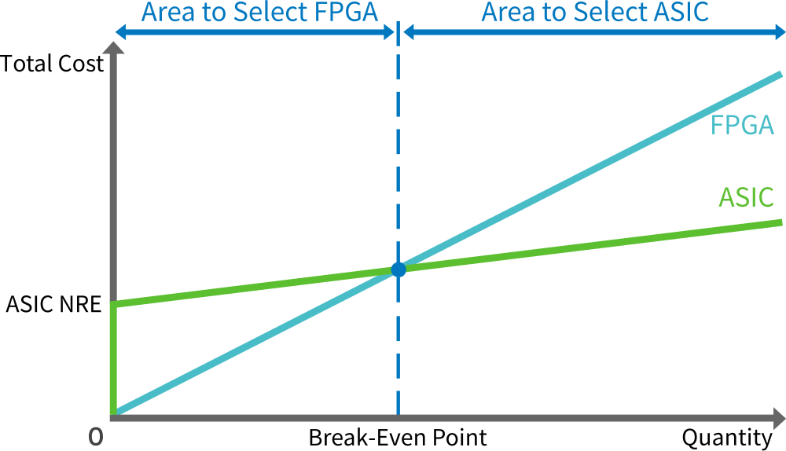
Price point

Slide 9
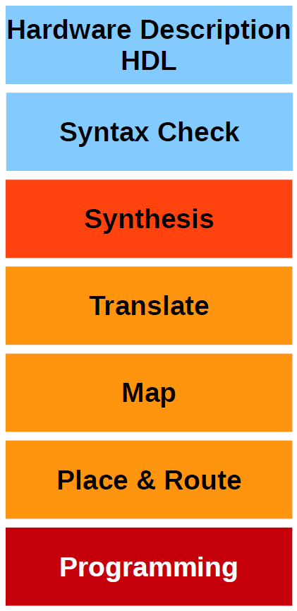
How “programming” a FPGA?
Describe what the hardware should do.
Check Syntax
“compiles” the design to transform HDL source into an architecture-specific design netlist. (connections)
Merges incoming netlists and constraints into a Xilinx design file
→ connections are merged with timing
Fits the design into the available resources
→ tell the FPGA which gate structures should be used
Places and routes the design to the timing constrains
→ decide, which gate is used for which function
Write configuration into the FPGA or configuration memory

